Slide 1
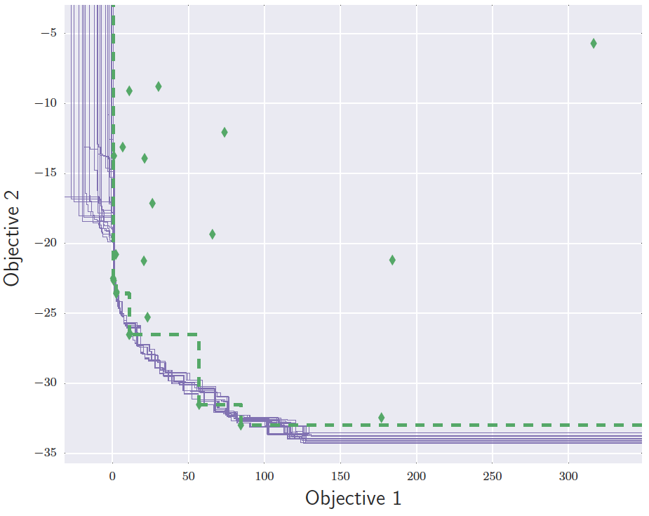
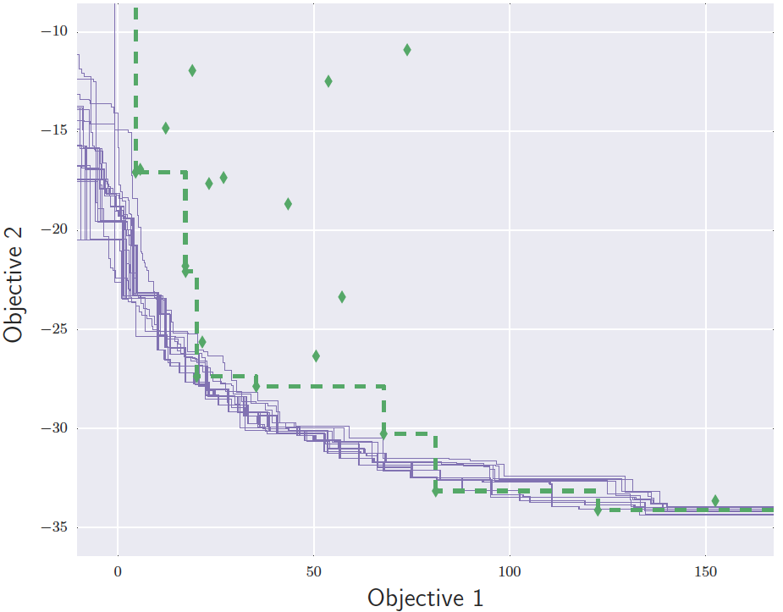
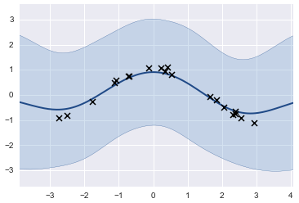
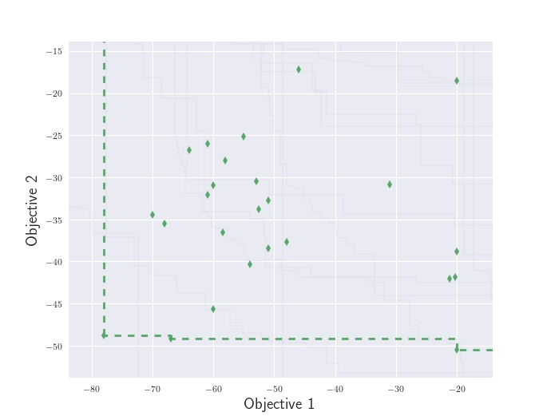
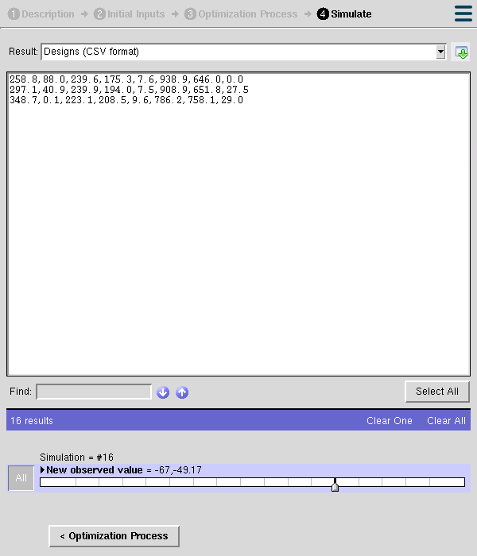
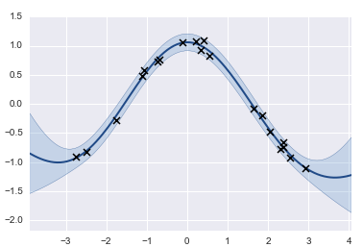
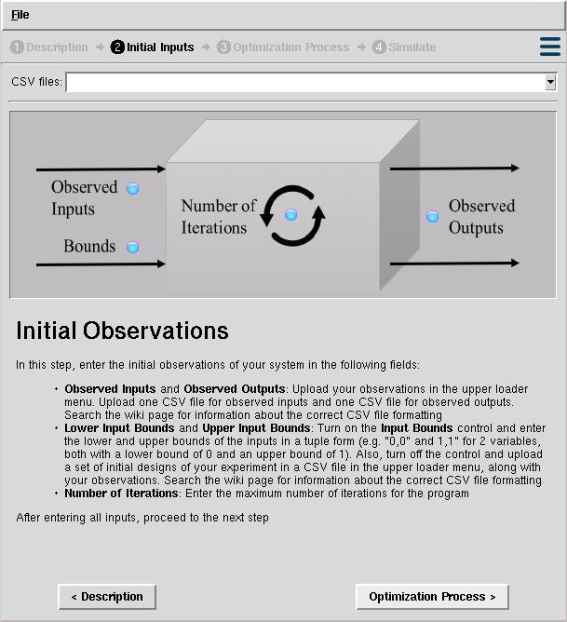
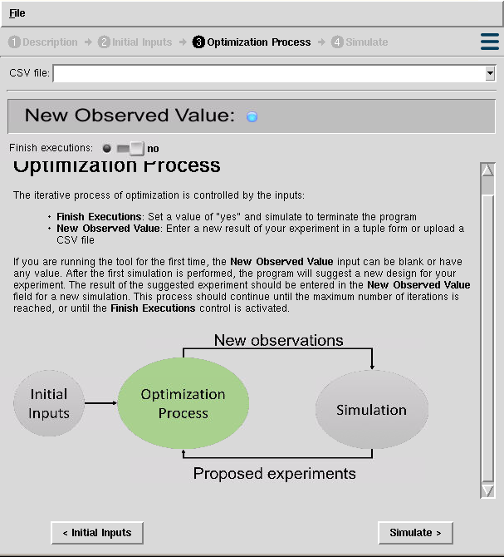
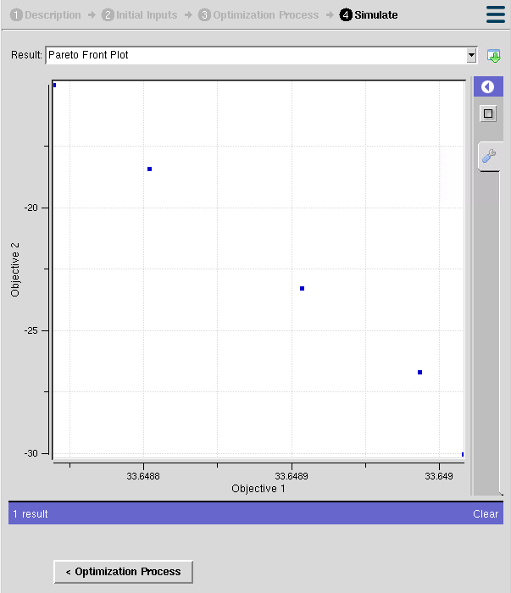
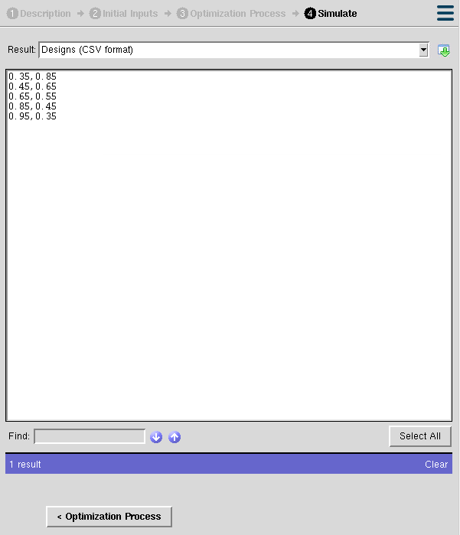

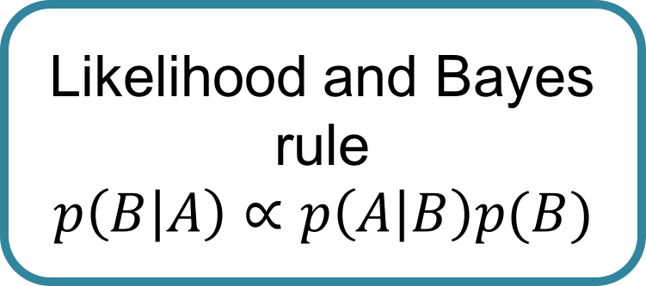
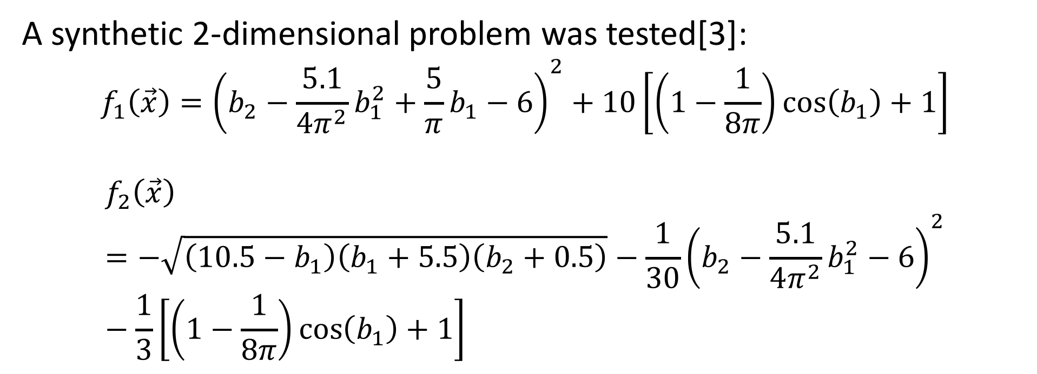
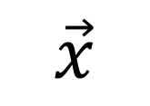
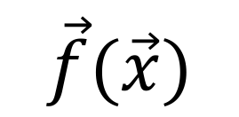
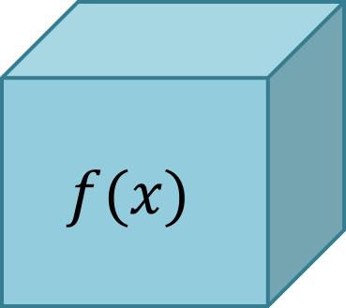


Gaussian Process Regressions for Objective Surrogates in Stochastic Multi-Objective Optimization
Juan Sebastian Martinez*, Piyush Pandita✝, Rohit Tripathy ✝, Ilias Bilionis ✝
*Department of Electric and Electronic Engineering, Universidad de Los Andes, Bogotá D.C, 111711, Colombia.
✝ Department of Mechanical Engineering, Purdue University, West Lafayette, Indiana, IN 47907, USA.
Background and Motivation…
The Methods…
A synthetic 2-dimensional problem was tested[3]:
$$f_{1}\left(\vec{x}\right)={\left(b_{2}−\frac{5.1}{4π^{2}}b_{1}^{2}+\frac{5}{π}b_{1}−6\right)}^{2}+10\left[\left(1−\frac{1}{8π}\right)\cos\left(b_{1}\right)+1\right]$$
$$f_{2}\left(\vec{x}\right)=−\sqrt{\left(10.5−b_{1}\right)\left(b_{1}+5.5\right)\left(b_{2}+0.5\right)}−\frac{1}{30}{\left(b_{2}−\frac{5.1}{4π^{2}}b_{1}^{2}−6\right)}^{2}−\frac{1}{3}\left[\left(1−\frac{1}{8π}\right)\cos\left(b_{1}\right)+1\right]$$
Optimization defines the situation where a function that describes the operation of a system should be minimized or maximized, restricted to some constraints imposed by the system itself.
Initial observations
Train GP surrogates
Project observations
Compute expected improvement
$$x$$
$$f(x)$$
$$y$$
Add new observation
Propose a design
Time
Materials
…
Heat dissipation
Cost
…
$$\min_{x}{f(x)}$$
General methodology
The optimization problem
Gaussian process regressions to build objective surrogates:
The Problem…
A Gaussian process (GP) is a collection of random variables, any finite number of which have a joint Gaussian distribution [1]
Real life optimization problems in science and engineering share similar issues:
Multiple objectives
Limited observations
Expensive experiments or evaluations of computer code
Black box systems
Noise in observations
Epistemic uncertainty
Prior Information and beliefs
Optimizing the compressive strength and the flow of concrete in a concrete slump test (from the UCI Machine Learning Repository):
Likelihood and Bayes rule
$$p\left(B | A\right)∝p\left(A | B\right)p(B)$$
Data Observations
?
Posterior
$$\vec{x}$$
$$\vec{f}(\vec{x})$$
Black box system
A Gaussian process regression
At the end…
Different approaches have been taken through evolutionary algorithms:
Large amount of observations required
Uncertainty is not considered
Our Results…
Using Gaussian process regressions is an effective method for building objective surrogates under uncertainty
The method allows experimentalists to obtain an optimal set of designs to apply in their experiments, with no extra costs or inefficient use of resources
Our Objective…
References
The Pareto front defines the set of optimal values for the objectives in the system being analyzed. Given an initial set of observations, an iterative optimization process discovers the front along with the corresponding experimental designs
[1] M. Seeger, Gaussian processes for machine learning. , vol. 14. 2004.
[2] Emmerich, Michael, and Jan-willem Klinkenberg. "The computation of the expected improvement in dominated hypervolume of Pareto front approximations." Rapport technique, Leiden University (2008).
[3] J. Parr, Improvement criteria for constraint handling and multiobjective optimization . PhD
thesis, University of Southampton, 2013.
Pareto Front
SMOOT (Stochastic Multi-Objective Optimization Tool):
https://nanohub.org/tools/smoot/

